Slide 1
OrderedDict in Python
DVT101 – Lecture 33
- By Dataverse Tutorials

Slide 2
What is OrderedDict?
Subclass of built-in dictionary
Remembers insertion order
Order-sensitive structure
Why it exists

Slide 3
Why OrderedDict is Needed
Older Python dict limitations
Consistent order guarantee
Advanced order control
Data structure use-cases

Slide 4
Where OrderedDict is Used
LRU cache design
Queues and stacks
Logging systems
JSON & form processing

Slide 5
Internal Working
Doubly linked list of keys
Hash table for fast lookup
Pointer-based ordering
Efficient reordering

Slide 6
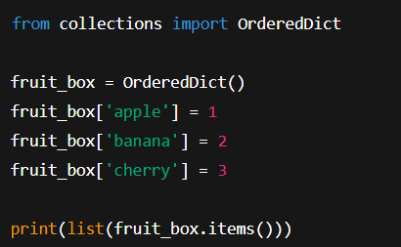
Creating OrderedDict
Using collections module
Initializing with pairs
Visualizing key sequence

Slide 7
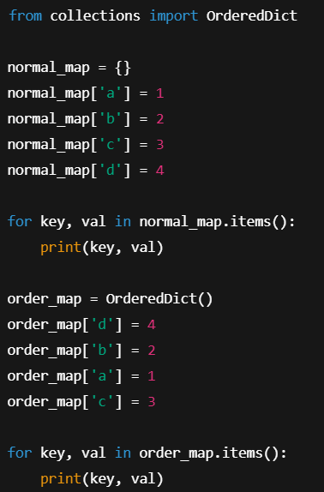
OrderedDict vs dict
Both preserve order
Only OrderedDict allows reordering
Equality behavior difference
Feature comparison

Slide 8
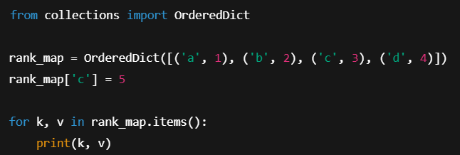
Updating Values
Value change without reordering
Stable key positions
Safe updates

Slide 9
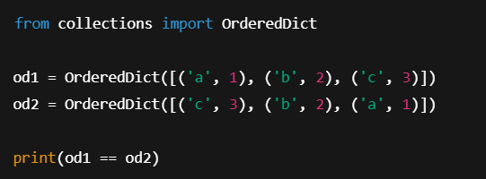
Equality Checks
Content and order check
Order-sensitive comparison
Validation use-cases

Slide 10
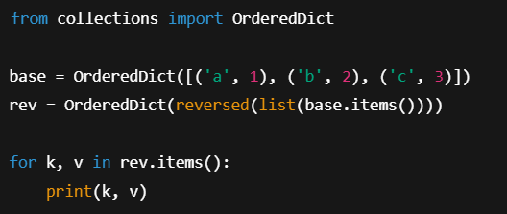
Reversing Order
Using reversed sequence
Creating new OrderedDict
Visualizing reverse flow

Slide 11
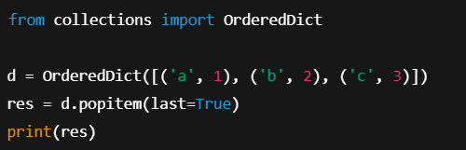
Pop from Ends
pop last element
pop first element
FIFO & LIFO logic

Slide 12
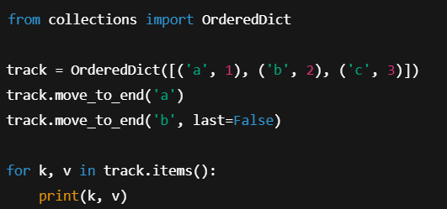
Moving Keys
move to end
move to front
Reordering logic

Slide 13
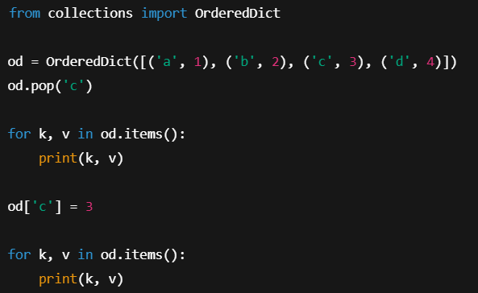
Delete & Reinsert Behavior
Removal effect
Reinsert at end
Recency tracking

Slide 14
Order Preservation Feature
Sequence-sensitive data
Log analysis
User interfaces

Slide 15
Performance Considerations
Slightly slower than dict
Memory trade-offs
When to use

Slide 16
Real-World Industry Use
Cache eviction systems
API request tracking
User activity logs

Slide 17
Common Mistakes
Assuming dict and OrderedDict same
Forgetting order matters
Unnecessary usage

Slide 18
Best Practices
Use when order logic needed
Combine with caching
Avoid for simple maps

Slide 19
Limitations
Slower than dict
Extra memory overhead
Not needed in Python 3.7+ basic use

Slide 20
When NOT to Use
Simple key-value store
Performance critical loops
No order logic

Slide 21
Summary & Key Takeaways
Order-aware dictionary
Advanced control
Ideal for LRU & logs

Slide 22


